Slide 1
Women’s International Shipping and Trading Association | www.WISTAInternational.com

Slide 2
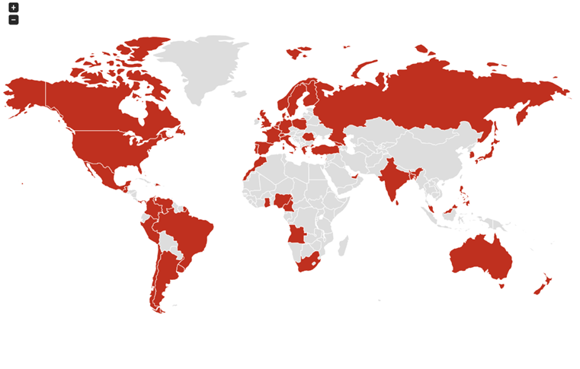
WISTA in Numbers
5100+ members
all segments of the industry
WISTA
59 countries
Diverse, Stronger, and Inclusive
The future of maritime trade & logistics industries

Slide 3
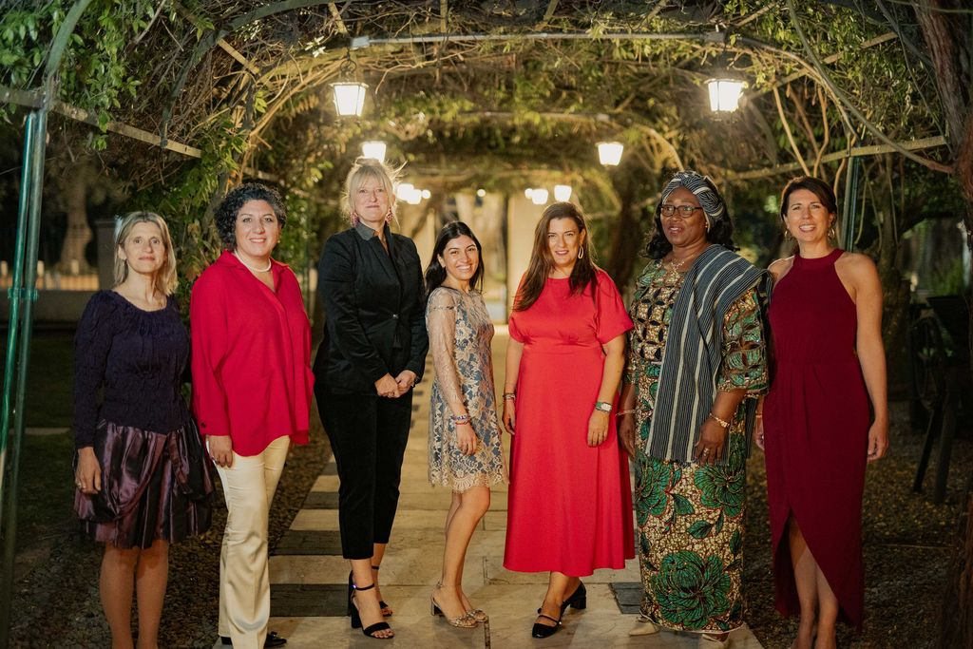
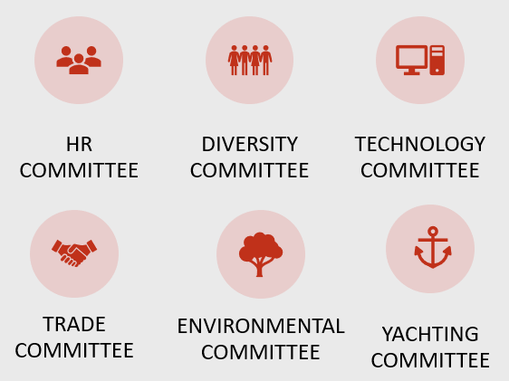
Committees
WISTA International ExCo 2023 - 2024
Dafne Angelidis
WISTA Argentina
Member
Meredith Kirby
WISTA USA
Member
Elpi Petraki
WISTA International
President
Connie Roozen
WISTA The Netherlands
Treasurer
Nazli Selek
WISTA Turkey
Member
Raimah Chowdhurry
WISTA Bangladesh
Member
Jemilat Jawula Mahamah
WISTA Ghana
Secretary

Slide 4
WISTA International Cooperation
IMO Consultative Status
WISTA International was approved for IMO Consultative Status by Council in July 2018
Women in Maritime-IMO & WISTA International Survey 2021
IMO-WISTA Speakers Bureau
UNCTAD Observer Status
WISTA International was granted Observer Status by the United Nations Conference on Trade and Development (UNCTAD) in July 2023

Slide 5
Further Education
Research Projects
IMO & WISTA Accelerator Program
ICS Scholarship
Women in Maritime | Training: Presenting with confidence NRF-WISTA
APEC SEN - WIMA - WISTA International Executive Certificate Course
Impact of Covid-19 on Women in Maritime
Diversity and Inclusion Pledge
Gender Diversity Handbook

Slide 6
WISTA Meetings & Conferences
Annual General Meetings and Conferences
2024 Limassol
2025 Barcelona
Regional Conferences
WISTA MED
WISTA Atlantic Forum
WISTA Nordic
WISTA Asia Pacific Region
WISTA Africa

Slide 7
PROFESSIONAL – DYNAMIC – COMMITTED - OPEN-MINDED
Women’s International Shipping and Trading Association www.wistainternational.com

